Slide 1

MS EXECEL DATA ANALYSIS
Streaming Service User Analysis

Slide 2





Formulas
& Steps
Objectives
Of Analysis
Graphs
& Charts
Analyse
Analysis
Based Decision
Summary

Slide 3
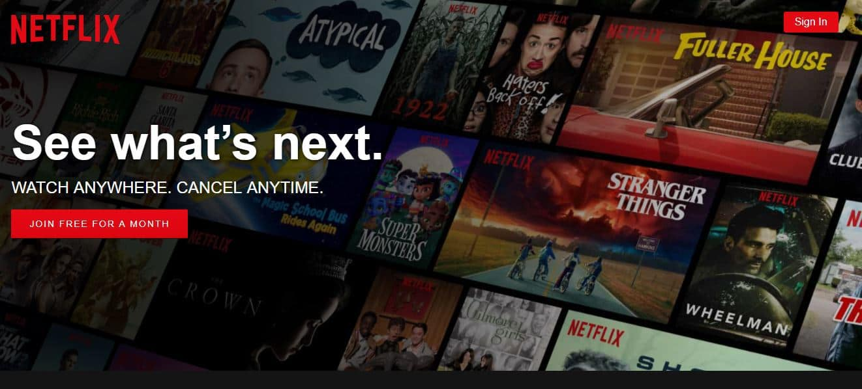
Formulas & Steps Used while Analysis
Data Cleaning Steps & Process:
1️⃣ Removing Duplicates
Identify and remove repeated entries to avoid inaccurate analysis.
Use Excel's Remove Duplicates feature to clean redundant data.
2️⃣ Handling Blank & Missing Values
Fill missing data using Mean, Median, or appropriate replacements.
Remove rows/columns with excessive missing values.
3️⃣ Standardizing Data Formats
Ensure consistency in date, currency, and text formats.
Example: Convert MM/DD/YYYY to DD/MM/YYYY for uniformity.

Slide 4

4️⃣ Fixing Data Entry Errors
Correct spelling mistakes, typos, and inconsistent capitalization.
Example: Standardize “usa”, “U.S.A”, and “United States” to one format.
5️⃣ Creating New Categories (Binning)
Group numerical data into meaningful categories.
Example: Loyalty Points ranges (0-1000, 1001-2000, etc.).
6️⃣ Consistent Naming Conventions
Standardize Genre, Language, Country and Payment methods names.
Example: Rename “india“, “ind”, “ INDIA” & “India" to a uniform format.

Slide 5
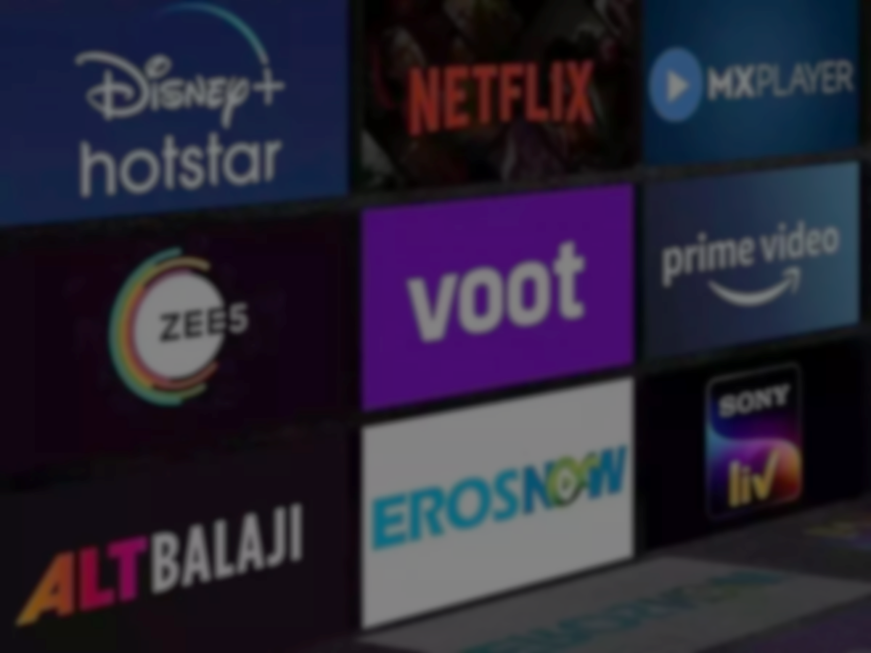
Added Extra Column’s as per need of the Analysis
Loyalty Points Range
Created Ranges for Easy Convenient Analysis in Graph.
Excel Formula used: =IF(T2<=1000, "0-1000", IF(T2<=2000, "1001-2000", IF(T2<=3000, "2001-3000", IF(T2<=4000, "3001-4000", IF(T2<=5000, "4001-5000", "5000+")))))
2. Engagement Score
Calculated Engagement Score using engagement metrics as per standard formula for the streaming Flatforms.
Engagement Score = (Watch Hours * 0.40) + (Total Movies Watched * 0.15) + (Total Series Watched * 0.15) + (Has Downloaded Content * 10) + (Average Rating Given * 2) + (Loyalty Points * 0.05) + (Active Devices * 0.025) + (Profile Count * 0.025)
Excel Formula: =(F2*0.4)+(K2*0.15)+(L2*0.15)+(Q2*2)+(R2*10)+(T2*0.05)+(H2*0.025)+(I2*0.025)

Slide 6

Main Objectives of Streaming Service User Analysis
Subscription & Revenue Analysis:
User Engagement Metrics
Demographic & Behavioural Insights:
Retention & Loyalty:
Payment Preferences & Regional Trends
Analysis of Genre & Engagement Score

Slide 7
Graphs & Charts Analyze
Subscription & Revenue Analysis:
○ Monthly revenue based on different subscription plans.
Subscription Plan
7.99
Monthly Price
Higher-tier plans (₹15.99 & ₹11.99) generate the most revenue, while ₹7.99 has more users but lower contribution.
Upgrading ₹7.99 users to premium plans can boost revenue, possibly through discounts or exclusive content.
No. Of Users

Slide 8
Subscription Plan
11.99
Subscription Plan
15.99
Monthly Price
No. Of Users

Slide 9
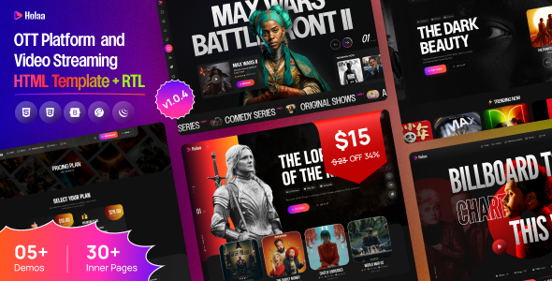
Subscription & Revenue Analysis:
○ Distribution of users across different price tiers.
Most users are subscribed to the ₹7.99 plan, but it contributes the least to revenue.
Fewer users opt for ₹15.99, but they drive the highest revenue per user.
Mid-tier plan ₹11.99 has a balanced user base, making it an ideal plan for upgrades from ₹7.99
Total
1000

Slide 10

2. User Engagement Metrics
○ Average watch hours per user.
○ Total movies vs. series watched per user.
Average watch hours per user are higher for premium plan users (₹15.99 & ₹11.99), while ₹7.99 users watch significantly less.
Movies are watched more frequently than series, but users on higher plans tend to watch more series, indicating a preference for long-form content.
Users with higher engagement (more watch hours & series watched) are likely to stay subscribed longer, making them valuable for retention strategies.

Slide 11

2. User Engagement Metrics
○ Impact of recommended content on engagement.
Users with higher "Recommended Content Count" have more watch hours, showing that personalized recommendations boost engagement.
Users engaging more with recommendations watch more series than movies, suggesting that tailored suggestions drive long-form content consumption.
Users who frequently watch recommended content have a lower churn rate, making personalized suggestions a key factor in retention.
Engagement Score increases with recommended content – Users with more recommendations (61-70 & 91-100) have the highest engagement (344.0 & 339.1).
Low recommendation counts (<1 & 21-30) show lower engagement, indicating that personalized recommendations drive more user activity.
Fluctuations in engagement (e.g., drop at 81-90) suggest that not all recommendations are equally effective, highlighting the need for better content curation.

Slide 12

3. Demographic & Behavioural Insights
○ Preferred genres by age group.
Younger users (18-25) prefer Action, Sci-Fi, and Thriller genres, indicating a strong interest in fast-paced and immersive content.
Users aged 26-40 engage more with Drama, Documentaries, and Crime genres, suggesting a preference for storytelling and real-life narratives.
Older users (41+) lean towards Classic Movies, Family, and Religious content, showing a shift towards nostalgic and meaningful viewing.

Slide 13
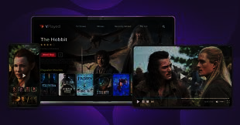
3. Demographic & Behavioural Insights
○ Device usage trends.
Smartphones are the most-used devices across all age groups, making mobile optimization crucial for user experience.
Smart TVs & Tablets are preferred by premium users (₹11.99 & ₹15.99 plans), indicating that high-tier subscribers favor big-screen experiences.
Laptops/Desktop usage is lower but shows a trend among working professionals, suggesting potential for integrating multitasking features like picture-in-picture mode.

Slide 14
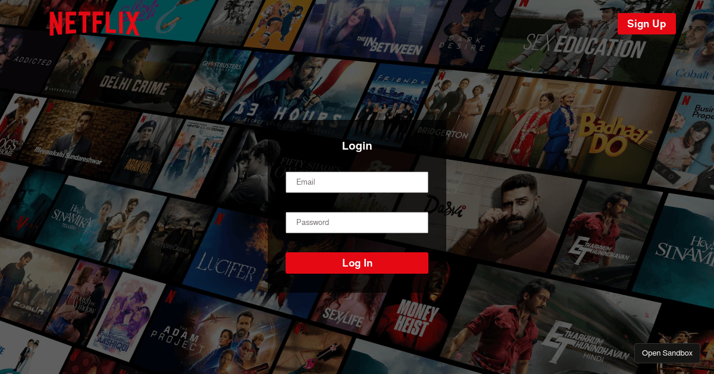
3. Demographic & Behavioural Insights
○ Peak watch time trends (Morning, Evening, Late Night).
Evening (6 PM - 11 PM) is the most active watch time, with the highest engagement across all user segments, indicating prime-time streaming habits.
Late Night (11 PM - 3 AM) sees a significant spike among younger users (18-25), suggesting binge-watching behavior and potential for night-time content promotions.
Morning (6 AM - 11 AM) has the lowest engagement, but is higher among older users (40+), who prefer news, religious, or short-format content.

Slide 15

Retention & Loyalty:
○ Membership status (Active vs. Inactive).
○ Loyalty points distribution.
Loyalty Points Distribution
Loyalty points vary significantly among users, with higher points linked to more watch hours and frequent logins.
Users with fewer loyalty points still maintain engagement, but at a lower frequency, indicating an opportunity to encourage more frequent viewing.
High loyalty point users tend to watch more series than movies, showing that long-format content contributes more to engagement.
Membership Status (Active vs. Inactive)
100% of users are active, meaning there are no inactive users in the dataset. This suggests strong engagement and retention, possibly due to effective recommendations or subscription renewal strategies.
Since all users are active, focus should shift to improving engagement levels rather than reactivation strategies.

Slide 16

Retention & Loyalty:
○ Frequency of logins and content downloads.
Users who download content tend to have higher engagement scores, indicating offline viewing is an important feature.
There is a positive correlation between content downloads and watch hours, meaning users who download are more likely to watch more content overall.
Users in certain age groups (likely 25-40) download more, possibly for travel or convenience.
Most users log in frequently, suggesting strong platform engagement.
Users with higher login frequency also have higher watch hours, proving that frequent logins lead to more content consumption.
A small percentage of users log in less frequently but still maintain decent watch hours, likely binge-watchers who consume multiple episodes in a single session.

Slide 17

Payment Preferences & Regional Trends:
○ Preferred payment methods by region.
1. Payment Preferences Overview
Certain payment methods are dominant in specific regions, indicating user preference based on convenience and availability.
Credit/Debit Cards are the most widely used payment method across multiple regions, showing a preference for traditional transactions.
Digital wallets (e.g., PayPal, Google Pay, UPI) are more popular in certain countries, especially where mobile transactions are common.
Regional Trends
North America & Europe: Prefer Credit/Debit Cards with a growing trend in PayPal usage.
India & Southeast Asia: Strong preference for UPI and digital wallets, indicating mobile payment dominance.
Latin America: Higher usage of local payment methods & bank transfers, showing regional adaptation.
Japan & South Korea: More reliance on subscription-based wallets & carrier billing through telecom providers.

Slide 18
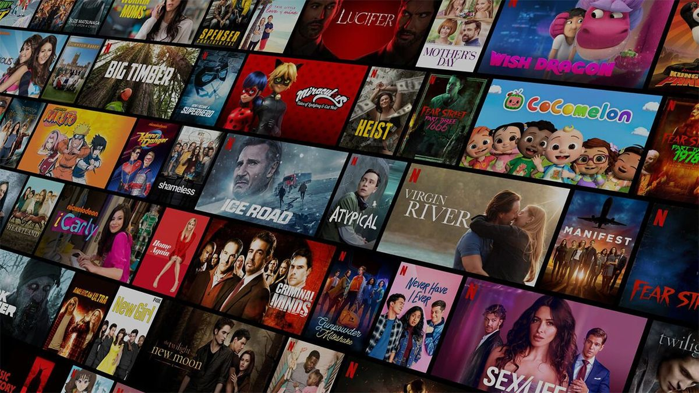
Payment Preferences & Regional Trends:
○ Subscription trends by country
Premium plans dominate in developed markets (USA, UK, Canada, Europe), while budget-friendly plans are more popular in India & Southeast Asia due to price sensitivity.
Latin America shows fluctuating renewals, likely due to economic factors, while Japan & South Korea have a mix of standard and premium plans, influenced by regional content.
Localized pricing, flexible payment options, and region-specific content can help improve subscriptions and retention across different countries.

Slide 19
Payment Preferences & Regional Trends:
○ Language preferences and their correlation with engagement
Users watching content in their preferred language have higher engagement, showing that language personalization boosts watch hours and retention.
Regional languages drive higher engagement in non-English-speaking countries (e.g., Hindi in India, Spanish in Latin America), while English remains dominant in global markets.
Users with multilingual preferences tend to have the highest watch hours, indicating that offering diverse language options can further enhance user engagement.

Slide 20
6. Analysis of Genre & Engagement Score
Comedy & Romance are Most Popular – Highest number of users and strong engagement.
Horror has High Engagement but Fewer Users – Niche audience but strong interaction.
Sci-Fi is the Least Preferred – Lowest user base and engagement, needs strategy improvement.

Slide 21
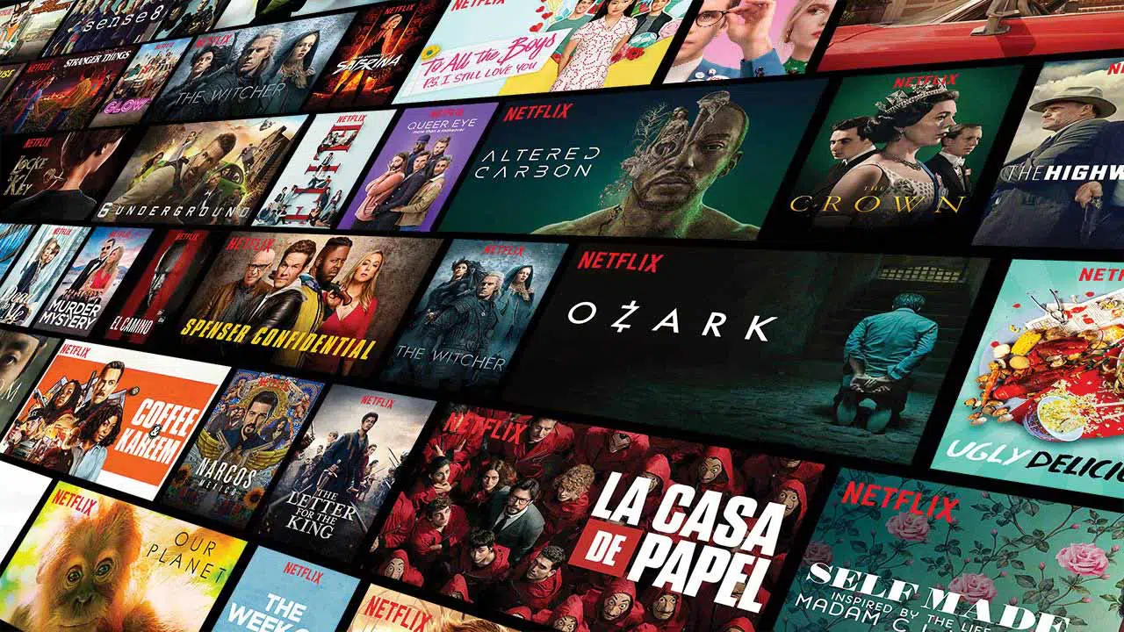
Summary
High Multi-Profile Usage & Account Sharing – Many users have multiple profiles, and some accounts show excessive device logins, indicating potential sharing.
Engagement Driven by Recommendations & Genre Preferences – Users engaging more with recommended content watch significantly higher hours; age groups also have distinct genre preferences.
Peak Streaming Trends & Device Usage – Most users stream during evening & late-night hours, with mobile & tablets devices being the dominant platform.
Subscription & Revenue Insights – Higher-tier plans contribute the most revenue, but a significant portion of users are on lower-cost plans, indicating pricing sensitivity.
Loyalty & Retention Are Strong, But Require Monitoring – Most users remain active, and loyalty points usage is high, but strategies should be optimized to boost long-term retention.

Slide 22
Analysis Based Decisions
Limit excessive profile usage – Restrict the number of profiles per account.
Detect & restrict unusual device usage – Implement geolocation checks & 2FA.
Optimize subscription plans – Introduce family/shared plans with controlled access.
Monitor concurrent streams – Enforce limits on simultaneous streaming.
Strengthen security & fraud detection – excessive device logins, high-profile switching frequency.

Slide 23
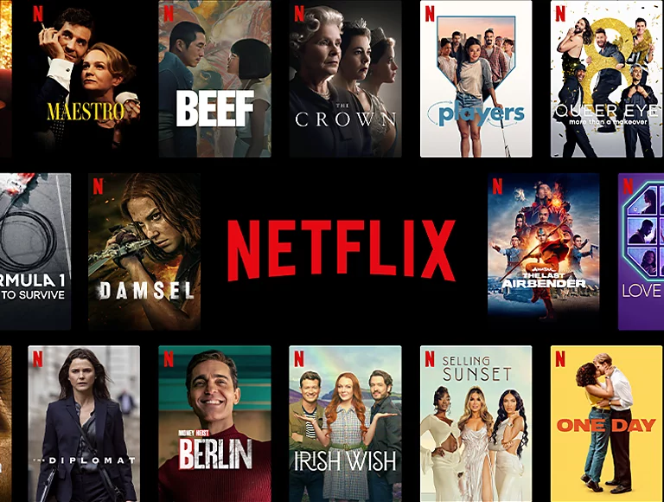

Thank You

